Slide 2
Proverif
secrecy
correspondence
observational equivalence(indistinguishability)

Slide 3
bound names: in a process
free names: known to all processes
variables

Slide 4
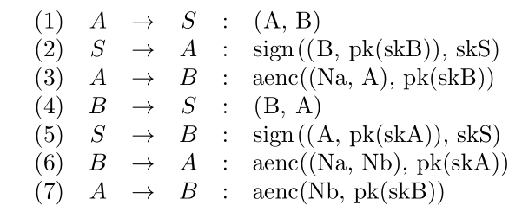
Needham-Shroeder public key protocol

Slide 5
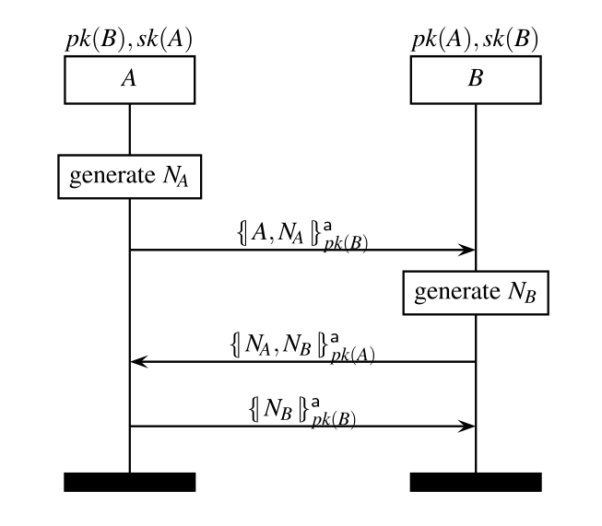

Needham-Shroeder public key
Simplified Version

Slide 6

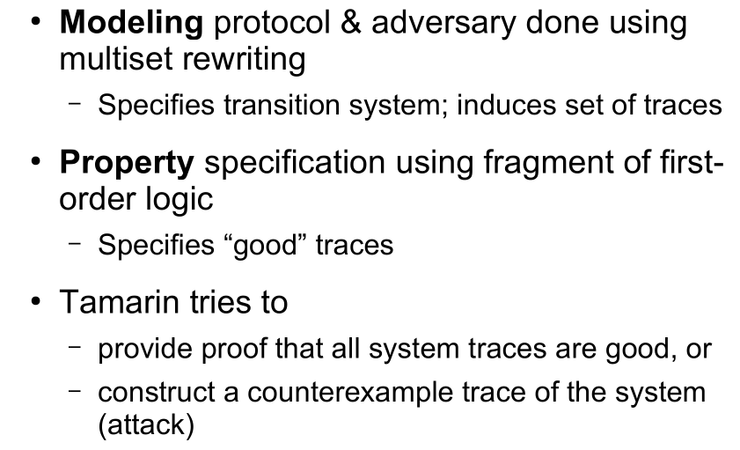
Tamarin

Slide 7
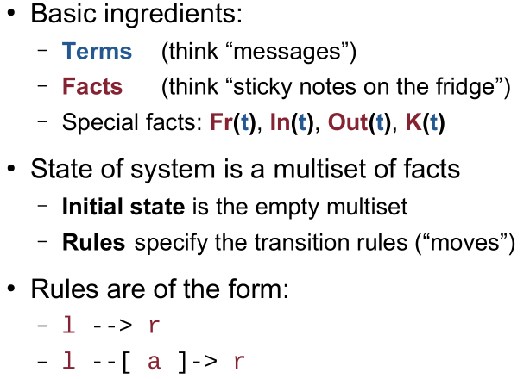
Modeling in Tamarin
the predicate on terms
sent out the message t on the public channel

Slide 8
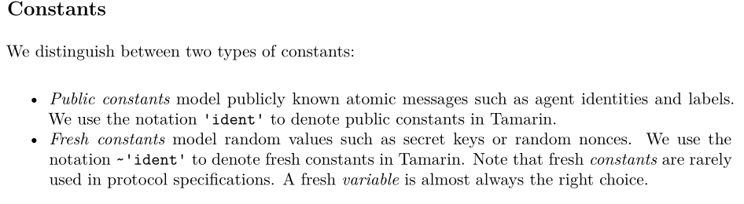
Terms - Cryptographic Messages

Slide 9
Terms - Cryptographic Messages
Function Symbols
built-in function symbols
user-defined function symbols
such like
pair, fst, snd
message theories: hashing, asymmetric-encryption, signing,diffie-hellman, bilinear-pairing, xor, and multiset
functions: f1/a1, ..., fn/an

Slide 10
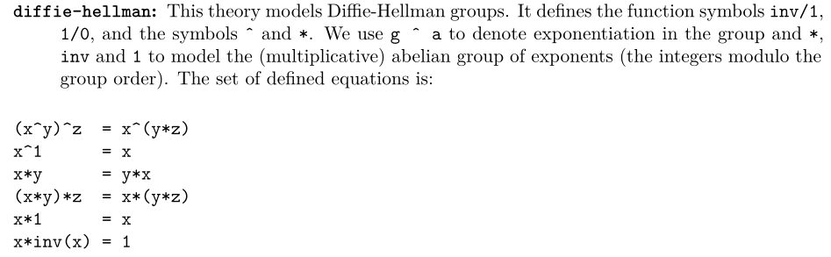
Terms - Cryptographic Messages

Slide 11
Terms - Equational theories
Equational theories can be used to model properties of functions
equations: lhs1 = rhs1, ..., lhsn = rhsn

Slide 12
Facts - Model Specification
SPECIAL FACTS
there is a fresh rule that produces unique Fr(...) facts;
and there is a set of rules for adversary knowledge derivation,
which consume Out(...) facts and produce In(...) facts.
Two types of Facts
Linear Facts:they might appear in one state but not in the next.
Persistent Facts:some facts in our models will never be removed from the state once they are introduced

Slide 13
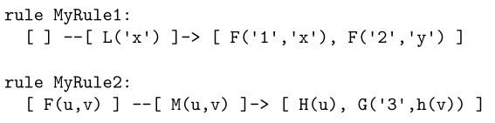
Rules - Model Specification
We use multiset rewriting to specify the concurrent execution of the protocol and the adversary.
A rewrite rule in Tamarin has a name and three parts, each of which is a sequence of facts: one for the rule’s left-hand side, one labelling the transition (which we call ‘action facts’), and one for the rule’s right-hand side. For example:

Slide 14
Property Specification
Trace Properties
A trace property is a set of traces.
We define a set of traces using first-order logic formulas over action facts and timepoints.
Observational Equivalence

Slide 15
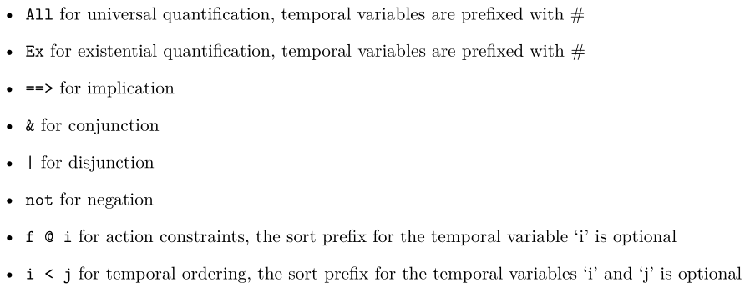
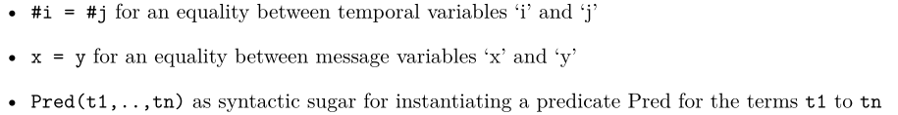
Property Specification
The syntax for specifying security properties is defined as follows:

Slide 16
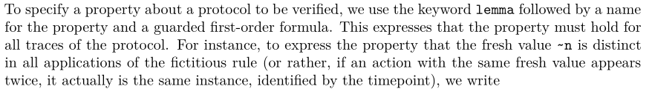
Property Specification

Slide 17
Tamarin Syntax
a Tamarin input file consists of:
Comments( C-like, single line: //, multiline: /* */)
starts with theory followed by the theory’s name
the keyword begin
cryptographic primitives declarations (the protocol process uses)
multiset rewriting rules declarations (modeling the protocol)
properties declarations ( lemmas to be proven)
the keyword end

Slide 18
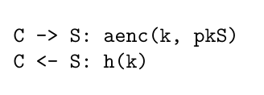
Example

Slide 19
Example
Begining and Cryptographic primitives

Slide 20
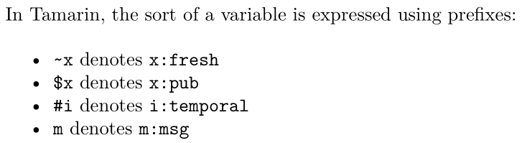
Example
Multiset Rewriting Rules declarations
i. first, generate a fresh name ~ltk, which is the new private key(Long-term key)
ii. non-deterministically choose a public name A for the agent for whom we are generating the key-pair.
iii. Afterward, generate the fact !Ltk($A, ~ltk) (the exclamation mark ! denotes that the fact is persistent).which denotes the association between agent A and its private key ~ltk,
iv. generate the fact !Pk($A, pk(~ltk)), which associates agent A and its public key pk(~ltk).

Slide 21
Example
Multiset Rewriting Rules declarations
modeling that the adversary can access any public key existing
[ !Ltk] --[LtkReveal(A)]-> [Out] modeling dynamic compromise of long-term key
the action facts is “ --[LtkReveal(A)]->”, showing that the Long-term key of A has been compromised.
action facts shown on the traces, other facts shown in the states

Slide 22

Example
Multiset Rewriting Rules declarations
C1 -> S1: aenc(k, pkS)
C2 <- S1: h(k)

Slide 23
Example
Multiset Rewriting Rules declarations
C1 -> S1: aenc(k, pkS)
C2 <- S1: h(k)
the action facts here is for allowing the formalization of the authentication property for the client , because security properties are defined over traces of the action facts of a protocol execution, using actions fact to record this knowledge.

Slide 24
Example
Properties declarations
Security properties are defined over traces of the action facts of a protocol execution

Slide 25
Example
Properties declarations

Slide 26
Example
Properties declarations

Slide 27
Example
Properties declarations

Slide 28
VIS
Verilog HDL

